Slide 1

Analysis of Toronto Benchmark Home Prices
Project 1 Team 3
Aditi Bindlish
Kelvin Wong
Peter Wang
Samantha Chow

Slide 2
Dataset
Toronto monthly housing price information, published by the Toronto Regional Real Estate Board (TRREB) based on the MLS Home Price Index.
Four home types included:
Single family detached: Benchmarks for “Single family homes” are generated as a composite of One- and Two-storey single family homes. These homes are independent structures that are typically built on land that exceeds the footprint of the building on each of its sides.
Single family attached: Benchmarks for “Attached single family homes” are calculated as a composite of One- and Two-storey attached single family homes. The term “attached” describes a home that is part of a larger multi-family building.
Townhouse: Townhouses have configurations which lay between apartment units and freehold non strata buildings. Owners typically pay co-ownership fees for maintenance and enjoy exclusive access to a part of the lot
Apartment: Apartment units are characterized by being part of a multi-unit building. There are also no parts of the lot whereby access is reserved for only one of the co-owners or apartment occupants.
Key data: Monthly MLS Benchmark Price per home type
Time period: July 2015 to March 2021
https://www.kaggle.com/code/alankmwong/exampletorontohousingindex
Notes:
Defintions: https://www.crea.ca/wp-content/uploads/2016/02/benchmark_home_definitions_for_tableau_en.pdf

Slide 3
Questions
What type of housing has gained in price growth over the years, and what has had a slower growth in price?
What were the highest prices of each property type over time, and which areas had these highest prices?
What is the overall trend of property values in the GTA over time?
Did prices double over time for some locations? If yes, how much time did it take? Were these areas near Toronto City?

Slide 4
Cleaning Data/Data Assumptions
Check data types - convert Date field to datetime format
Check for null values - determine which null values we can keep/remove
When calculating average/max/min, nulls are ignored
One area (Barrie) had nulls for all fields, therefore, we removed this area from the dataset as it does not provide any value
For each question, simplify the data needed to answer the question by excluding extraneous columns

Slide 5
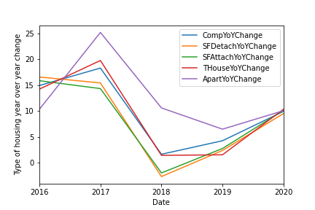
What type of housing has gained in price growth over the years?

Slide 6
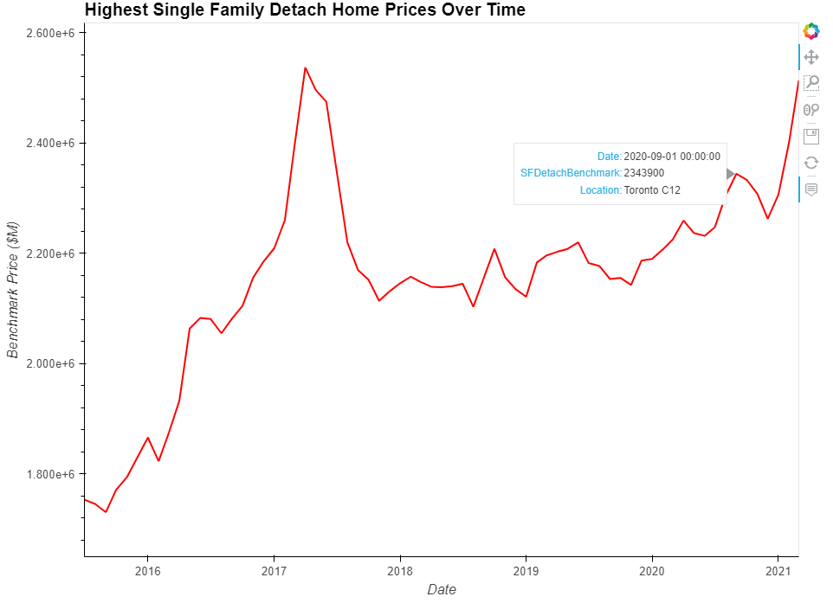
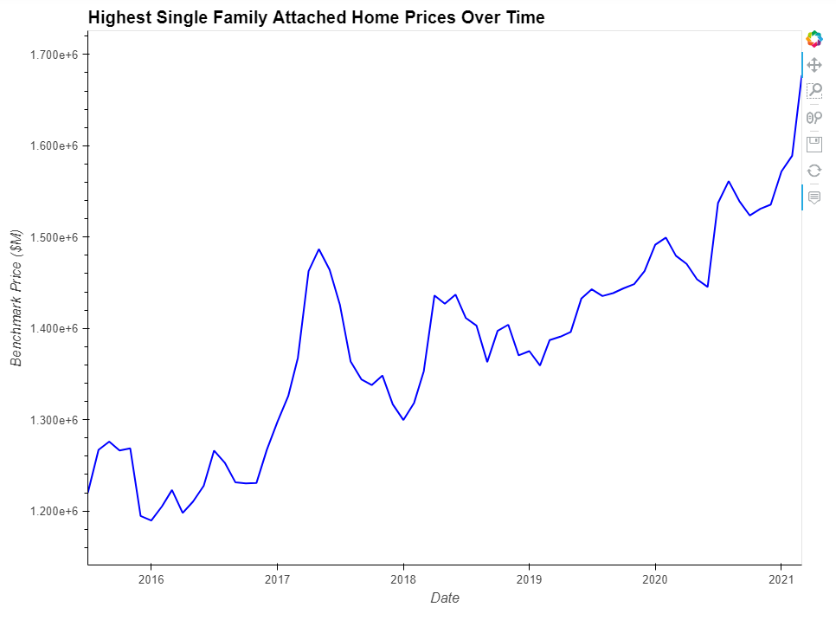
What were the highest prices of each property type over time, and which areas had these highest prices?
'Toronto C12'
'Toronto C09', 'Toronto C02', 'Toronto C08'
Notes:
For each home type, sort the data by Date and benchmark prices highest to lowest
Looked at only the highest benchmark price per month
Looked at which areas made up the highest benchmark prices
Hvplot for hover abilities
Single family detached home prices
- peak was in April 2017 at $2.537M
- followed by steep decrease in prices to a low of $2.1M before climbing back up
- March 2021 climbed back up to near the peak at $2.513M but has not surpassed the 2017 peak
- Toronto C12 (Bridle Path/Hoggs Hollow) has had the highest prices in this category every month since July 2015
Single family attached home prices
- also had a peak in May 2017 at $1.487M (Toronto C02)
- higher than ever since 2015 at $1.677M in March 2021 (Toronto C02)
- only three areas to have the highest prices
Toronto C09 - Rosedale-Moore Park
Toronto C02 - Annex-Wychwood
Toronto C08 - Downtown East

Slide 7
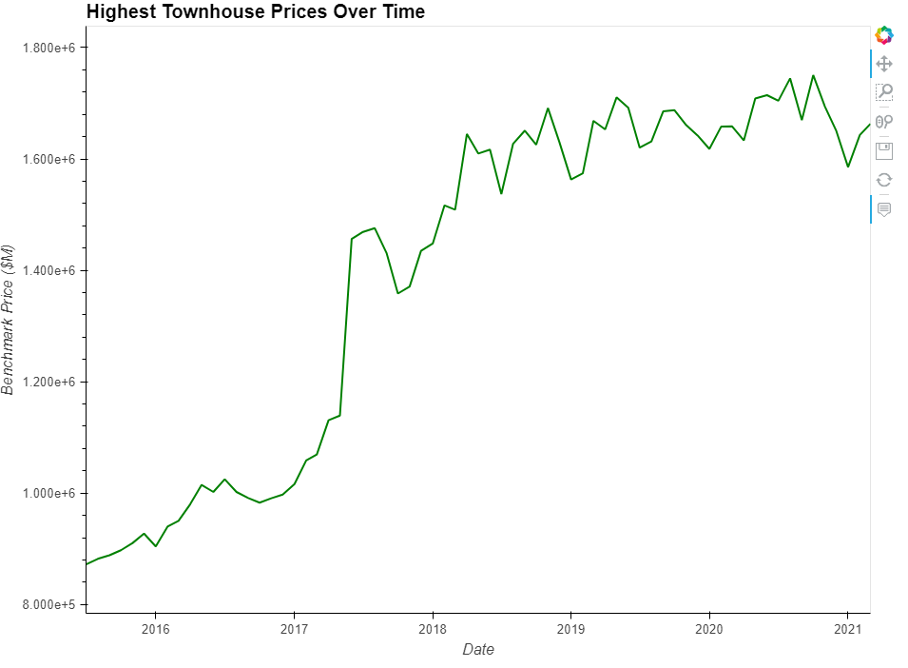
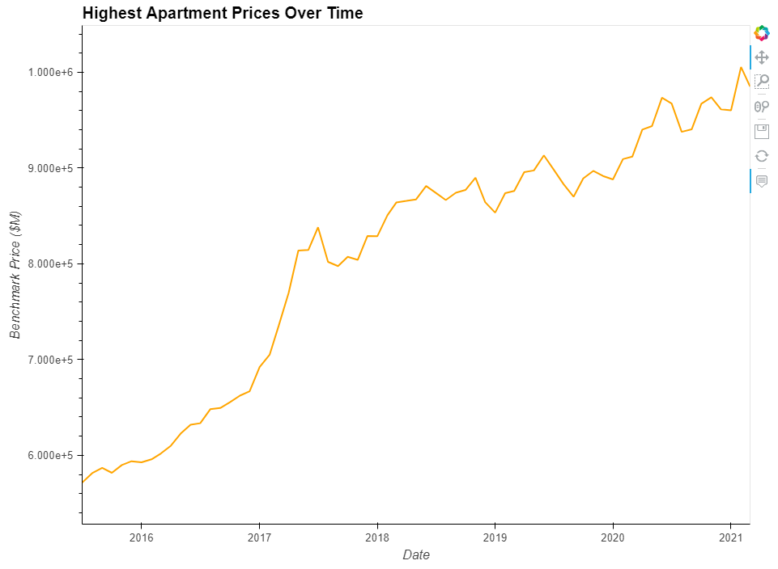
What were the highest prices of each property type over time, and which areas had these highest prices?
'Toronto C02', 'Toronto E02', 'Toronto C09'
'Toronto W02', 'Toronto E02', 'Toronto C03', 'Toronto C12'
Notes:
All areas are in Toronto
Townhouse and Apartment trend more similar vs Houses are similar
More volatility in the houses
Townhouses
- steep increase in June 2017 when prices jumped $100k
- peak in October 2020 at $1.75M (Toronto C09)
- after prices past the $1.5M mark, they've not had as much fluctuations in prices staying between $1.5 and $1.75
- three areas with the highest prices over time:
Toronto C02 - Annex-Wychwood
Toronto E02 - Beaches
Toronto C09 - Rosedale-Moore Park
Apartments
- more gradual MoM increases than in the houses
- steady rise from July 2015, however steep increase in Jan-July 2017 when prices hit $838k (Toronto C03)
- continuing to increase over time to peak of $1M in February 2021 (Toronto C03)
- before 2017, Toronto W02 Junction-High Park had the highest prices, but Toronto C03 - Forest Hill dominated prices for most months from then on
- four areas of high prices:
Toronto W02 - Junction-Runnymede
Toronto E02 - Beaches
Toronto C03 - Forest Hill-Oakwood
Toronto C12 - Bridle Path-Hoggs Hollow
Overall: for single family houses (detached and attached), we see the prices sharply come back down after the housing bubble in 2017. However for townhouses and apartments, they didn't really fall back down but instead continued to rise over the next few years

Slide 8
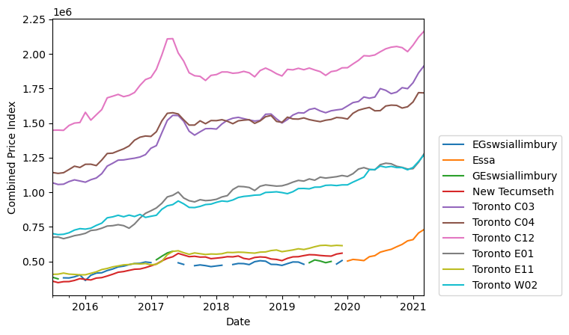
What is the overall trend of property values in the GTA over time?
From the graph, the housing price in all areas is getting rising throughout the years.
There is a sharp pitch in the general housing price in the year of 2017.
For all the areas, there are relatively higher increase in general price after 2020.

Slide 9
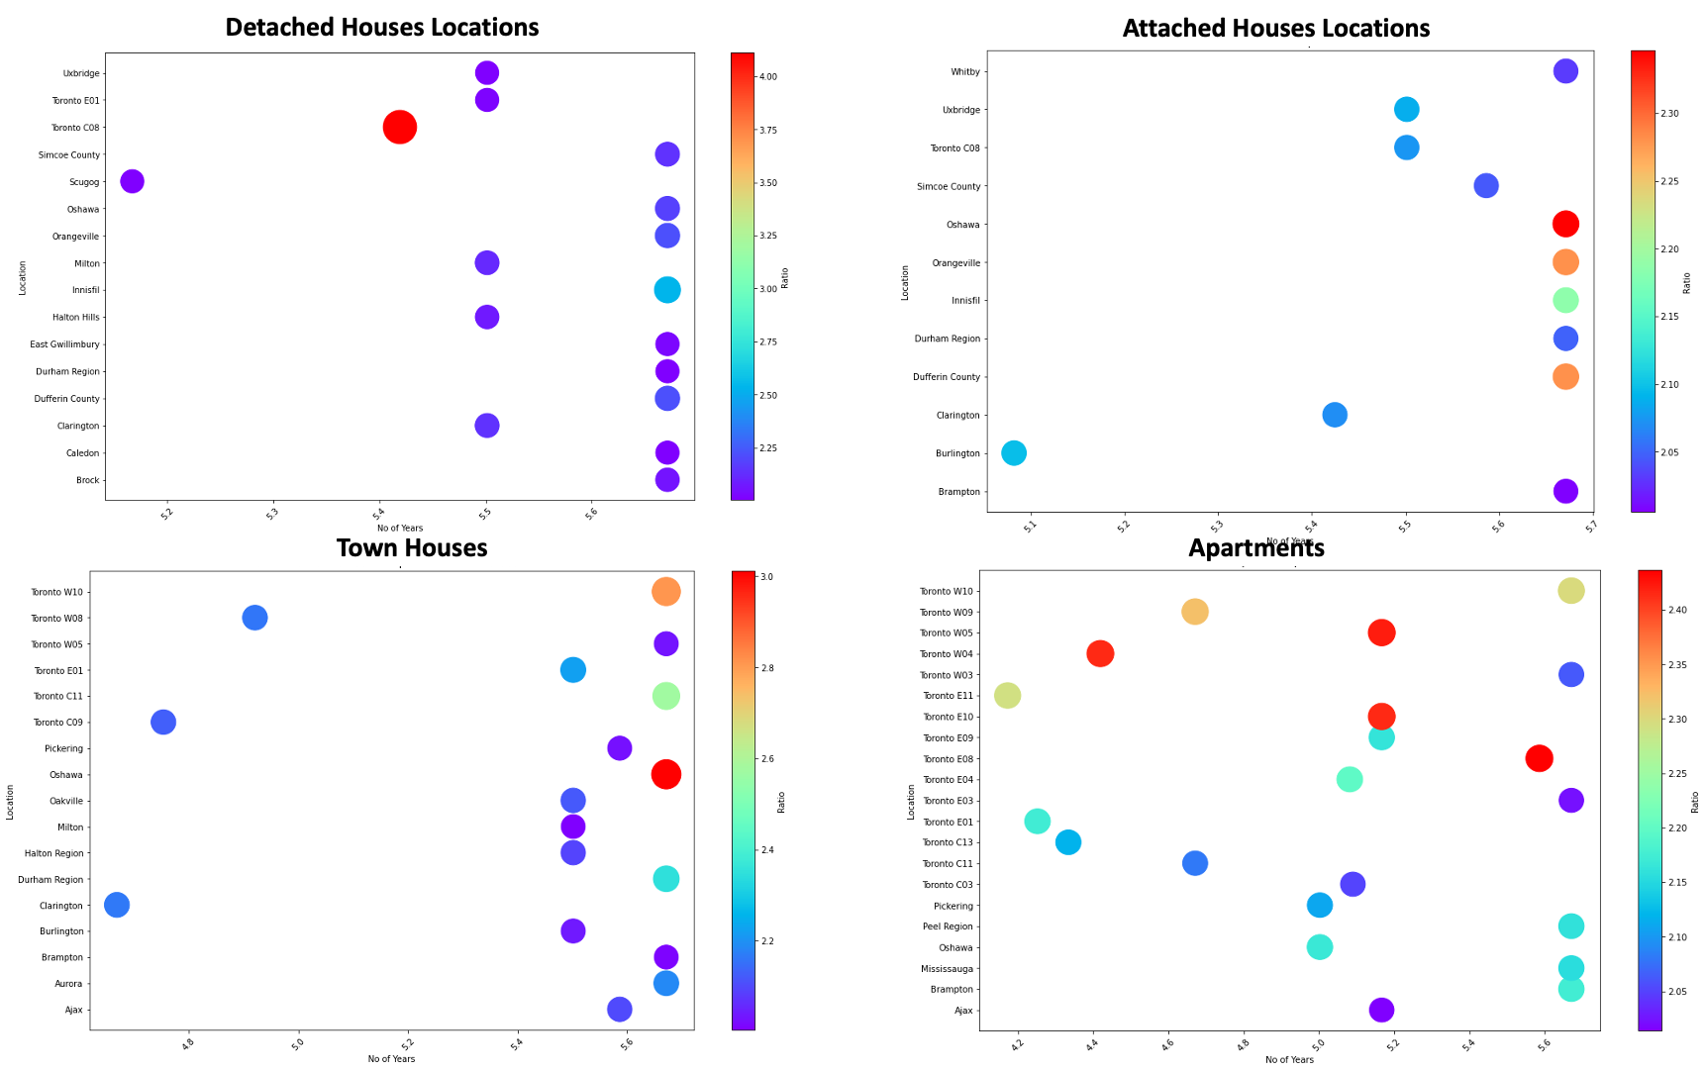
Did prices double over time for some locations? If yes, how much time did it take?
Oshawa was the only location where prices doubled for all categories
Prices doubled in 5yrs to 5.7yrs for most locations, many apartments saw doubling in price in <5 yrs
Size of the bubbles represent number of times the prices rose from 2015 to 2021
Appendix
Notes:
-quickest doubling seen in apartments, also maximum 20 locations saw price doubling in apartments, townhomes 16 (3 locations <5yrs), detached 15, attached 11
-Oshawa highest in attached (2.3x) and townhouses (3x), areas in toronto in detached (4x) and apartments (2.4x)

Slide 10
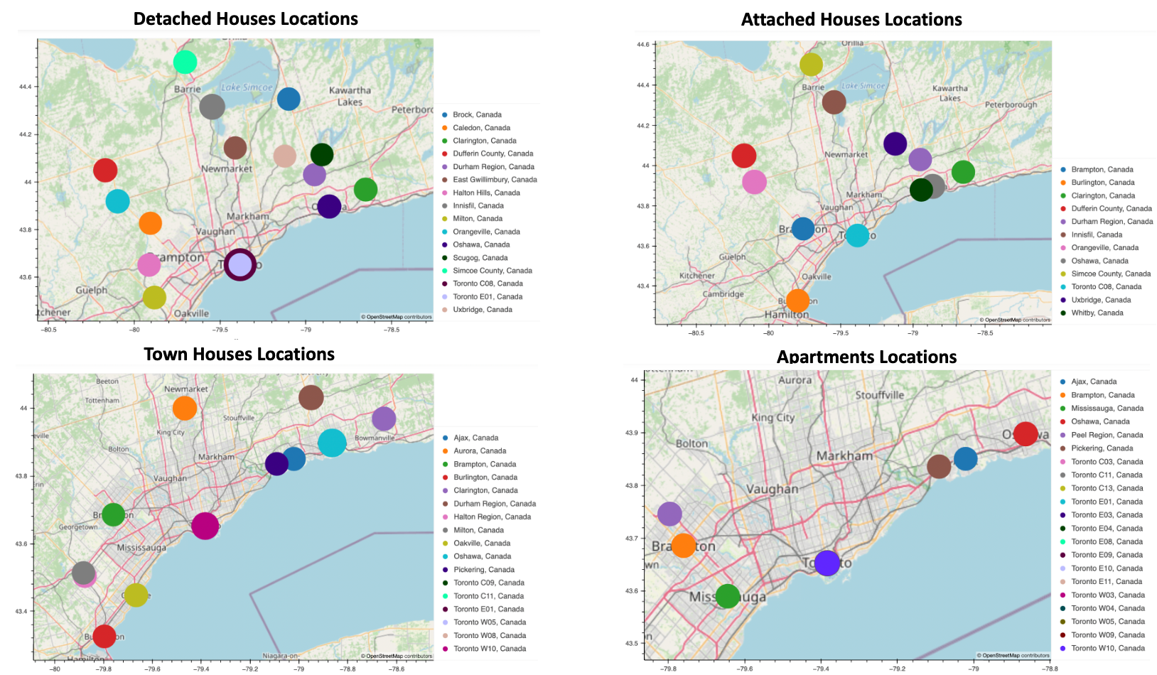
Were these areas near Toronto City?
Locations where prices doubled are spread throughout GTA
No concentration is apparent in area or direction towards Toronto City, infact, most areas are away from the densely populated Toronto
Size of the bubbles represent number of times the prices rose from 2015 to 2021
Appendix
Notes:
-Locations in entire GTA saw price doubling, not just Toronto or nearby areas

Slide 11
Questions?

Slide 12
Appendix

Slide 13
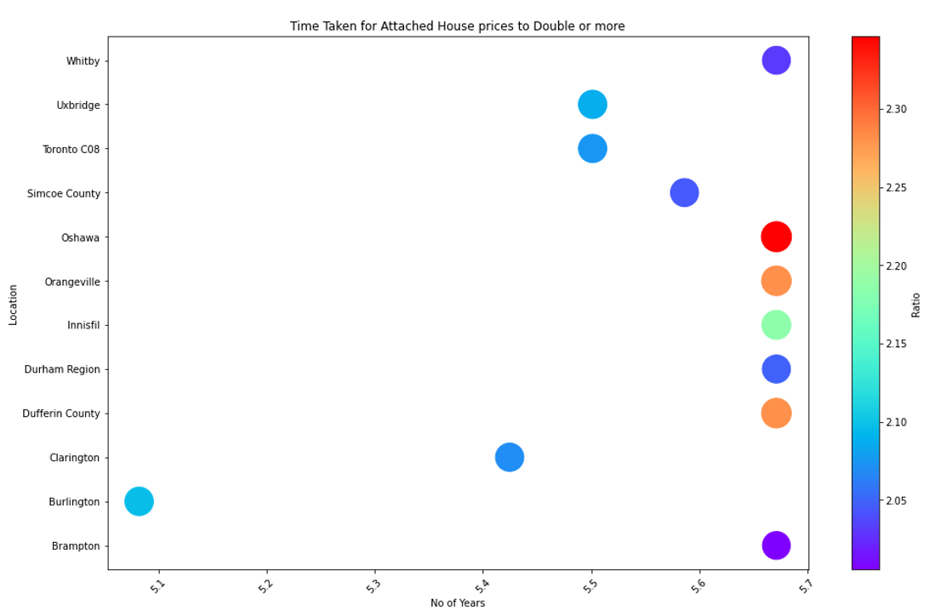
Back

Slide 14
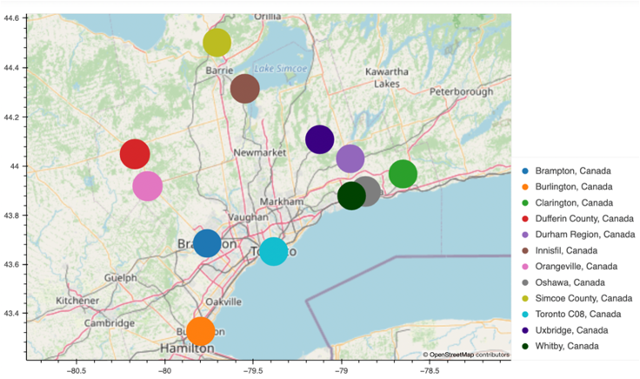
Back

